Slide 1
Integrating Random Forest Classification with Spark and MongoDB for Intrusion Detection
Presented by
Radja BELARBI
08/07/2025
University of Palermo - UNIPA

Slide 2
Data (UNSW-NB15)
Context & Motivation
Rapid growth in cyber threats and attacks
Importance of early detection in securing network infrastructure
Traditional systems struggle with scalability and real-time analysis
Problem Statement
Classifying malicious vs. benign network sessions in large-scale traffic logs
Handling imbalanced data and high-dimensional features
Proposed Solution
Use Random Forest classifier for robust, interpretable decision-making
Leverage Apache Spark for scalable data preprocessing and model training
Store results in MongoDB and generate predictions for analysis and visualization
Preprocessing (Spark)
Model
(Random Forest)
Evaluation
Output
(MongoDB + CSV)

Slide 3
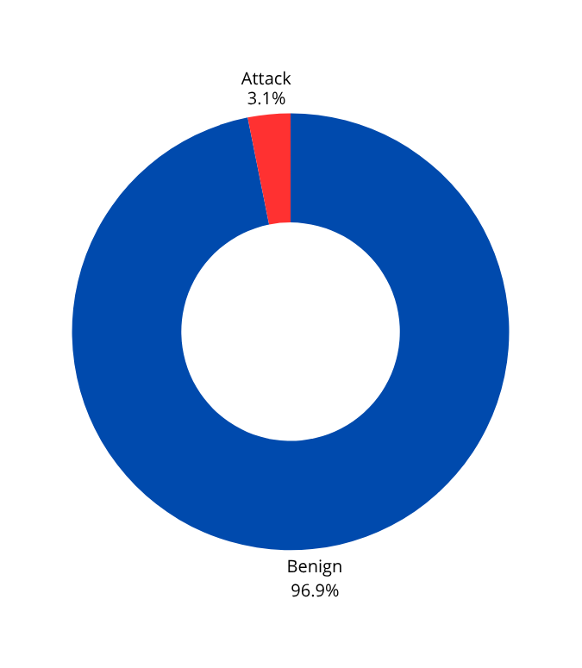
Dataset and Source
Dataset Source:
https://www.kaggle.com/datasets/mrwellsdavid/unsw-nb15?select=UNSW-NB15_1.csv
Composition:
Total records: 700k
High class imbalance
Label: Binary (0 = Normal, 1 = Attack)
Features:
42 input features
Packet-level, flow-level, time-based, and content-based
Mixture of categorical and numerical features
Some examples: dur, sttl, dttl, sbytes, dbytes, state, ct_state_ttl, tcprtt, etc.
Attack Categories:
Exploits, Fuzzers, DoS, Reconnaissance, Backdoors, Shellcode, Worms, etc.
Label Distibution

Slide 4
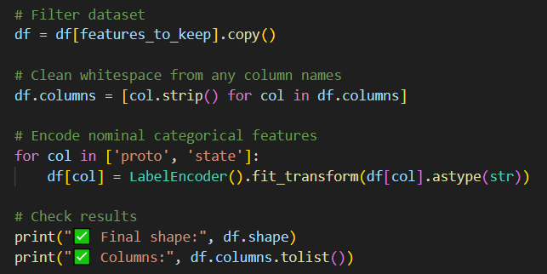
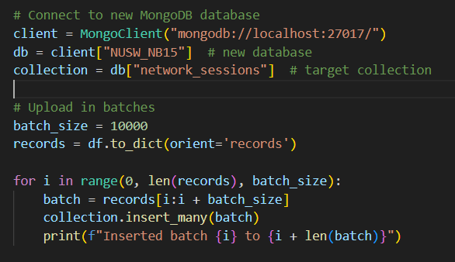
Tools & Technologies
Tool/Library | Purpose
Apache Spark | Distributed data processing, feature engineering, model training
MLlib (Spark ML) | Machine learning (Random Forest Classifier, evaluation metrics)
MongoDB | Storing input data and saving prediction results
Python (PyMongo) | Automating MongoDB database/collection creation
Java | Main implementation of Spark ML pipeline and Random Forest model
CSV Output | Exporting predictions for external visualization/analysis

Slide 5
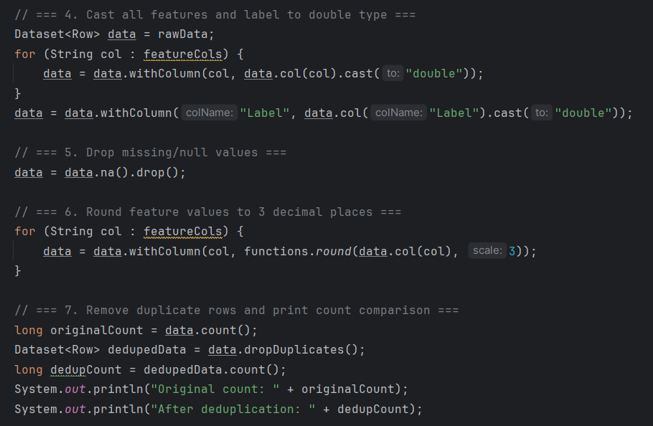
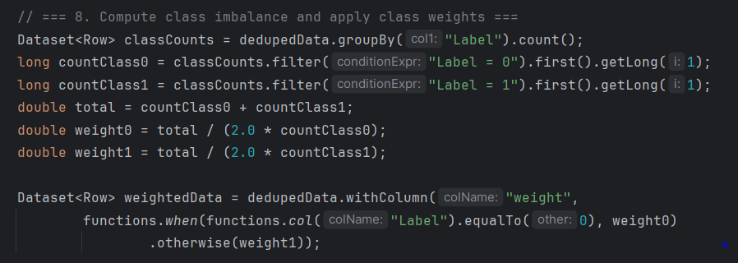
Preprocessing Pipeline
Data cleaning: Cast to double, drop nulls, round floats
Categorical features were directly cast to numeric (e.g., "proto", "state")
Deduplication
Handling class imbalance: Class weighting
VectorAssembler: to prepare features

Slide 6
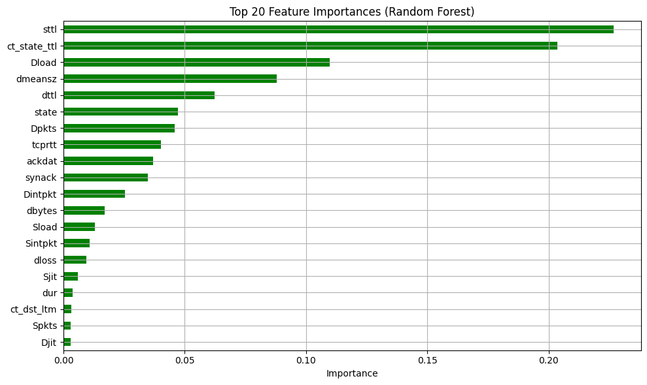
Model: Random Forest Classifier
why Random Forest:
Handles high-dimensional data
Robust to overfitting
Configuration:
numTrees=100
weightCol="weight" to balance classes
Pipeline stages:
Assembler → RF Classifier (All Features)
Feature importance selection → RF Classifier (Top 20)

Slide 7
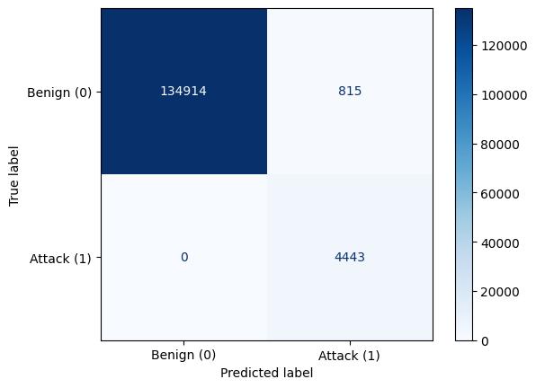
Evaluation Metrics
Global Metrics
Metric | Formula | Value
Accuracy | TP+TN/FP+FN+TP+TN​ | 99.4%
F1-Score | 2⋅Precision+Recall/Precision⋅Recall​ | 99.4%
Precision | TP/TP+FP | 99.5%
Recall | TP/TP+FN | 100% (attack)
Confusion Matrix
Per-class breakdown:
Class 0 (benign): Precision = 1.0, Recall = 0.994, F1 = 0.997
Class 1 (attack): Precision = 0.845, Recall = 1.0, F1 = 0.916

Slide 8
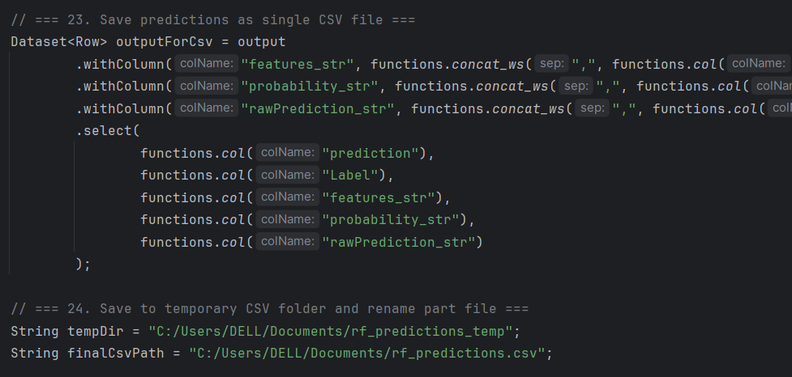
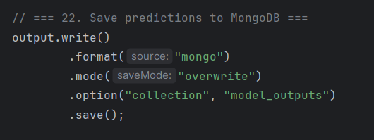
Output Storage
MongoDB:
Save predictions + probabilities
New collecion was created via Spark “model.outputs”
Fields stored: prediction, label, features, rawPrediction, probability
CSV Output:
Export all the necessary metrics and the top 20 features for external visualizations

Slide 9
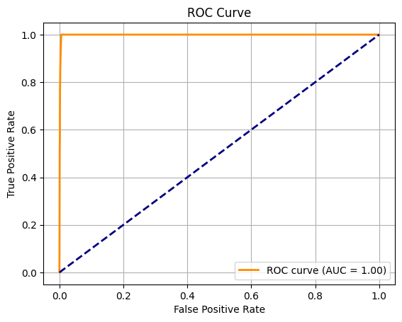
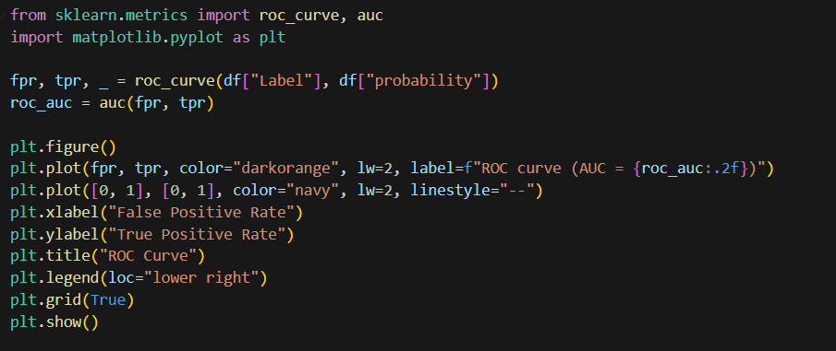
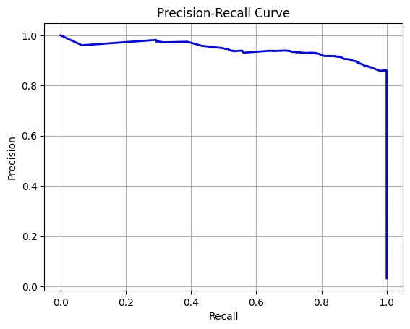
Python Visualizations
ROC Curve:
Precision - Recall Curve:

Slide 10
Challenges & Solutions
Imbalanced dataset → used class weights
Feature selection → used feature Importances
Spark-Mongo integration
Conclusion:
Achieved very high accuracy on a realistic, complex dataset
Spark pipeline is scalable for real-time cyberattack detection
MongoDB enables easy integration with other systems
Future Work:
Try other models: Gradient Boosted Trees, Deep Learning (Auto-encoders for anomaly detection)
Real-time streaming with Spark Streaming
Advanced feature engineering

